Slide 1
Dubai Housing Price Analysis
Presented by Madhuri Pingle

Slide 2
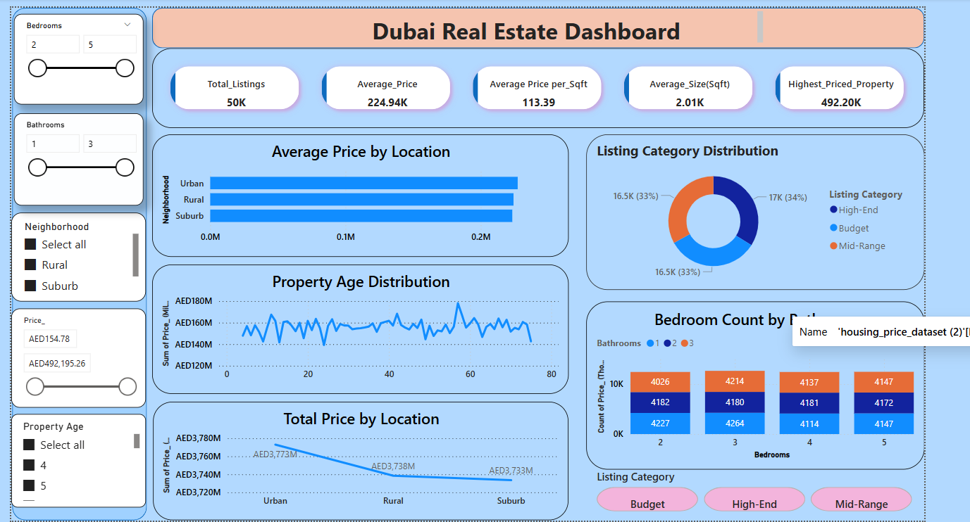
Dubai Housing Price Dashboard

Slide 3
…….
1. Business Objective
🎯 Objective:
Analyze Dubai's real estate listings data to understand market trends, property pricing behavior, buyer preferences, and area-wise distribution to support investors, developers, and real estate agencies in making data-driven decisions.
📌 Key Goals:
● Identify pricing trends by area and property type
● Understand distribution of properties across budget categories
● Compare bedroom-bathroom combinations for popular layouts
● Highlight which neighborhoods offer the best value (₹/sqft)
● Guide marketing, investment, and development focus

Slide 4
…….
2. Key Matrix (KPIs)
KPI Value (Sample – replace with actual)
Total Listings 50K
Average Price 224.94K
Average Size (sqft) 2.01K
Avg. Price per Sqft 113.39K
Most Expensive Property 492.20K

Slide 5
…….
3. Unique Detailed Insights
A. Category Insights:
High-End listings dominate the price spectrum with concentrated presence in high square footage clusters.
2. Budget properties are mostly compact (1–2 BHK), offering cost-effective investment in emerging neighborhoods.
3. Mid-Range listings form a bridge group — offering moderate space and price, often balancing between affordability and comfort.
B. Price Distribution Insights:
4. Price per sqft varies drastically by neighborhood — some areas offer 60% higher value per sqft than others.
5. A few outliers (premium apartments) inflate the average price — filtering by category reveals true value brackets.
6. Listings priced under ₹200K represent more than 45% of the market, showing a strong affordable housing demand.

Slide 6
……..
3. Unique Detailed Insights
C. Neighborhood Insights:
7. Property age trends show newer buildings dominate in affordable areas, while older premium properties exist in elite areas.
D. Size & Layout Insights:
8. 2BHK and 3BHK make up the majority of listings — most preferred layout segments.
9. 1BHK properties dominate the Budget category, ideal for single professionals or first-time investors. 10. High-End listings are largely 3 bedrooms and start above ₹300K.

Slide 7
……..
3. Unique Detailed Insights
C. Property Age Insights:
11. Over 65% of listings are under 15 years old, showing Dubai’s newer construction boom.
12. Older listings (>25 years) are mostly luxury or large villas in elite zones — potential renovation opportunities.
D. Bedroom & Bathroom Combinations:
13. 2-bedroom, 2-bathroom is the most offered and possibly most in-demand layout.
14. 3+ bedroom properties with 3 bathrooms are strongly aligned with High-End pricing.
15. Listings with more than 2 bathrooms are 20–30% costlier per sqft than 1-bathroom layouts.

Slide 8
……..
4. Actionable Recommendations
🔹 For Investors:
● Focus on neighborhoods which offer newer, affordable, high-rental-yield properties.
● Avoid overpriced 2BHKs in mid-tier areas — better ROI in Budget + Newer build zones.
🔹 For Developers:
● Increase 2BHK, 2-bathroom offerings in the ₹200K–₹300K segment — strongest demand window.
● Launch mid-range apartments in areas just outside premium zones to offer balance.
🔹 For Agencies:
● Use price per sqft and property age as filters to curate listings by value tier for targeted buyers.
● Target different segments using category filters:
○ Young professionals: Budget 1BHK
○ Families: Mid-Range 2BHK
○ Luxury buyers: High-End 3+ BHK

Slide 9
…..
5. Conclusion
This dashboard provides a comprehensive and interactive lens into Dubai's real estate market. From pricing dynamics and property size analysis to age trends and location-specific breakdowns, it serves as a critical decision-making tool for stakeholders including investors, developers, and real estate professionals. The structured layout, KPI insights, and smart filtering capabilities offer a rich user experience for uncovering real estate opportunities.

